Slide 1
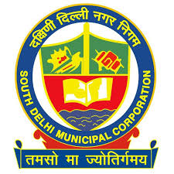
Expressions of Interest Energy Saving Street Lights Conversion (LED, PV)
For improved energy efficiency in South Delhi Municipal Corporation Area.
The South Delhi Municipal Corporation (SDMC) is seeking a qualified private sector partner to supply, install, operate, maintain, and manage phase-1 of converting street lights along the major street network to energy saving technology (LED and solar) (the Project). This phase includes about 40,000 light fixtures consisting of mostly 250W HPS lamps directly under SDMC's control. The EOI documents and details can be downloaded from http://www.mcdonline.gov.in/tri/sdmc_mcdportal/ or scan the QR code given below.
Qualified firms with adequate resources, experience, and track record interested in the Project are requested to submit their respective Expression of Interest (EOI) before 12:00 PM on 6 February 20xx.
This document is for educational purpose only it has no relation with SDMC in any way.
Logo used here is for representation purpose only this is not an actual document.
South Delhi Municipal Corporation,
Address : 780, Major Somnath Marg,
Sector 9, R.K. Puram, New Delhi - 110022
Telephone : +91 95607 xxxxx
Email : xxxx@xxxx.in
Scan me for
Full Document
www.mcdonline.gov.in/tri/sdmc_mcdportal/

